Slide 1
Business Analytics
Toolbox - BA775
Summer 2021
Lecture 08
Professor: Mohammad Soltanieh-ha

Slide 2


Slide 3
Final presentation on Aug 31
B1: 9 a.m. - noon ET
B2: 1 p.m. - 4 p.m.
15 minutes presentation + 3 minutes Q&A on Zoom
You can use slides + dashboard
As a part of your project you should complete your notebook and via Slack send the .ipynb version to me by Monday 08/30, 5pm ET. This notebook will be sent to another team that will be acting as the stakeholder during your presentation.
The stakeholder team will study the notebook and prepare their questions. The questions will have a direct impact on the class participation grade. Answers will impact the project grade.
Everyone in the class will vote on the presentation quality of all the other teams.

Slide 4
Project Survey (on the final presentation)
Did you feel that you had the opportunity to contribute to the work of your teammates in a productive environment?
Rate your teammate based on the following: Contribution - Communication - Teamwork - Innovative solutions - Work ethics - Accountability
Rate team X based on the following (examples for the criteria):
Mastery of the subject: Was the presenter team able to answer questions? Were they able to explain the problem and justify the analytical approach?
Innovative solutions: Were new and innovative solutions/methods used in this work?
Knowledgebase: Was proper background information on the topic provided? Was the material selected for the presentation appropriate to the topic? Were irrelevant and filler information excluded?
Presentation skills: Were the main ideas presented in an orderly and clear manner? Were the presenters responsive to audience questions?
Slides/presentation organization: Was the story easy-to-follow? Were the objectives clear? Was there a logical structure in place?
Teamwork: Was the entire team involved in presenting and/or answering questions?

Slide 5
Final deliverable rubrics
Category | Weight
Dashboard | 5
Problem definition | 1
Storyline & cohesiveness | 2
SQL mastery | 3
Notebook organization and use of Markdown | 2
Quality of questions | 2
Quality of answers | 2
Conclusions | 3
Total | 20

Slide 6
Topics Covered
SQL - arrays & structs
Machine learning
Classification with logistic regression
Linear regression

Slide 7
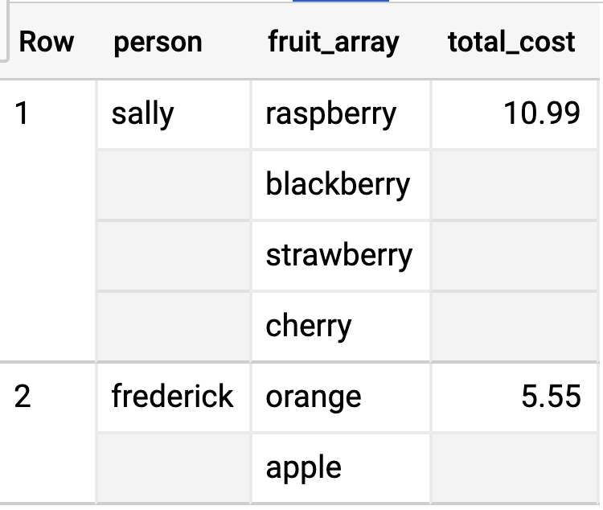
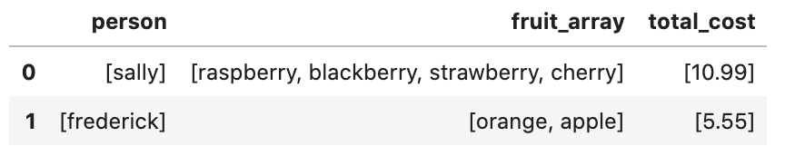
ARRAYs
In BigQuery
Shown in BigQuery: REPEATED
In BigQuery, an array is an ordered list consisting of zero or more values of the same data type. You can
construct array literals
build arrays from subqueries using the ARRAY function
and aggregate values into an array using the ARRAY_AGG() function
For example:
SELECT person, fruit_array, total_cost
FROM `data-to-insights.advanced.fruit_store`
In Jupyter Notebooks

Slide 8
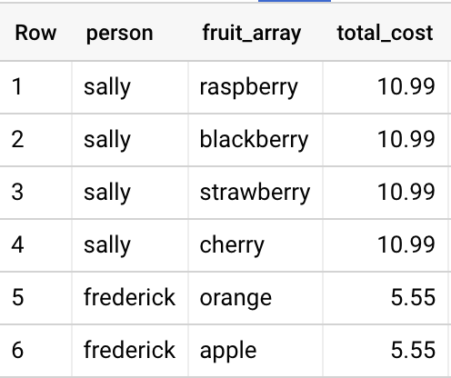
ARRAY-type fields in a STRUCT
To convert an ARRAY into a set of rows, also known as "flattening", use the UNNEST operator. UNNEST takes an ARRAY and returns a table with a single row for each element in the ARRAY.
SELECT person, fruit_array, total_cost
FROM `data-to-insights.advanced.fruit_store`,
UNNEST(fruit_array) AS fruit_array

Slide 9
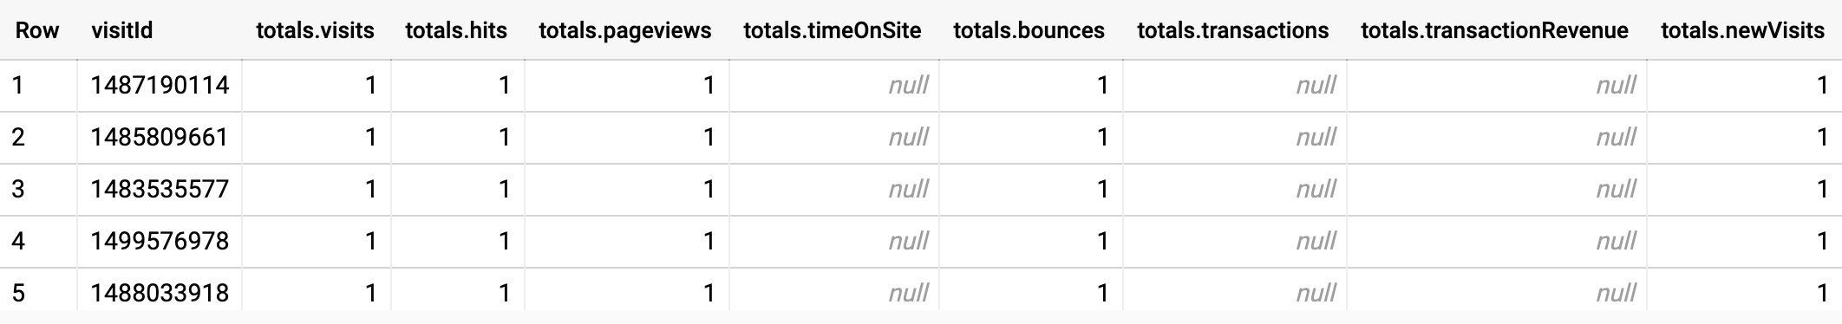
STRUCTs
To specify nested or nested and repeated columns, you use the RECORD (STRUCT) data type.
Data type shown in BigQuery: RECORD
For example:
SELECT visitId , totals FROM `data-to-insights.ecommerce.web_analytics`

Slide 10
TIMESTAMP_TRUNC()
Truncates a timestamp to the granularity of date_part.
TIMESTAMP_TRUNC(timestamp_expression, date_part[, time_zone])
SELECT
TIMESTAMP_TRUNC(pickup_datetime, MONTH) month,
COUNT(*) trips
FROM `bigquery-public-data.new_york.tlc_yellow_trips_2015`
GROUP BY 1
ORDER BY 1
More info can be found here.

Slide 11
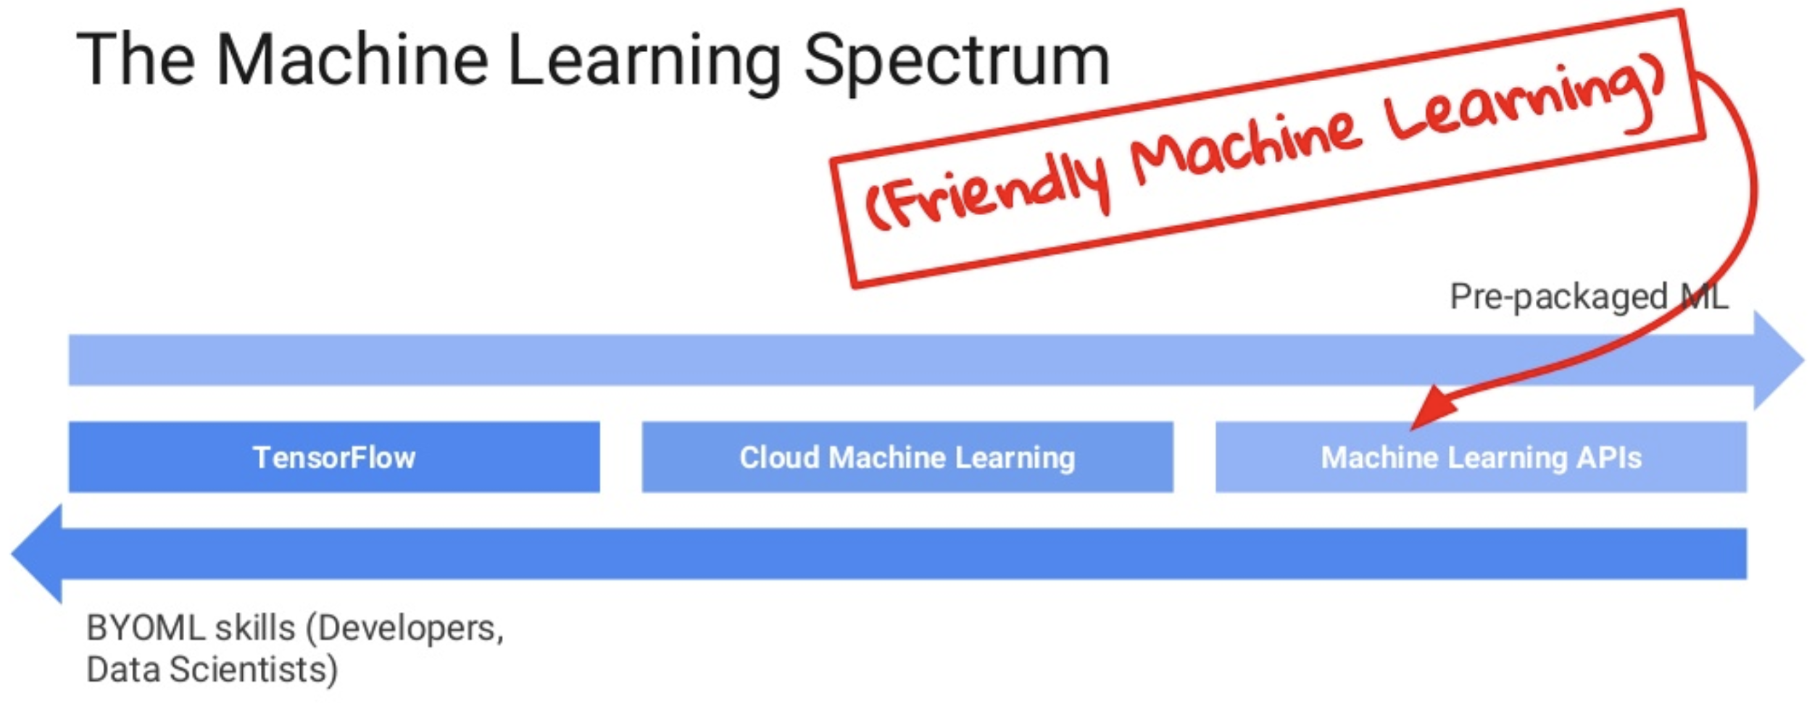
ML on GCP

Slide 12


ML uses standard algorithms to derive predictive insights from data and make repeated decisions
This way
That way
Data
Algorithm
Predictive insight
Decision

Slide 13

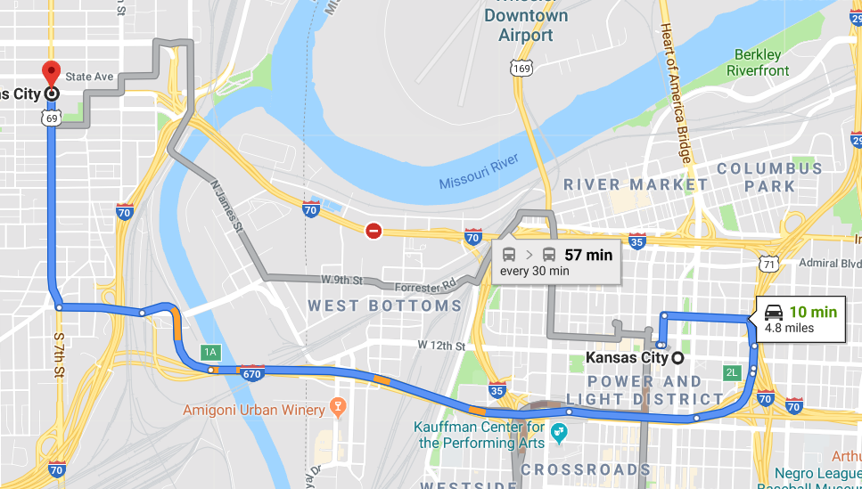
ML uses standard algorithms
TAX
Estimate the tax I owe
How long will it take me to get home?

Slide 14


Model training requires examples
Examples of tax filings
Examples of trips

Slide 15
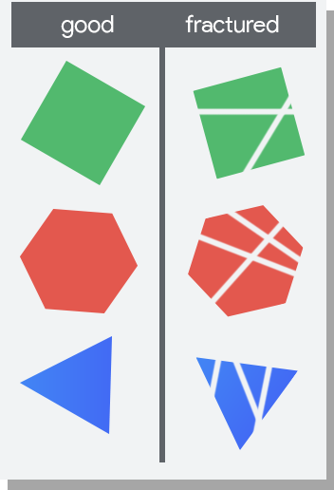
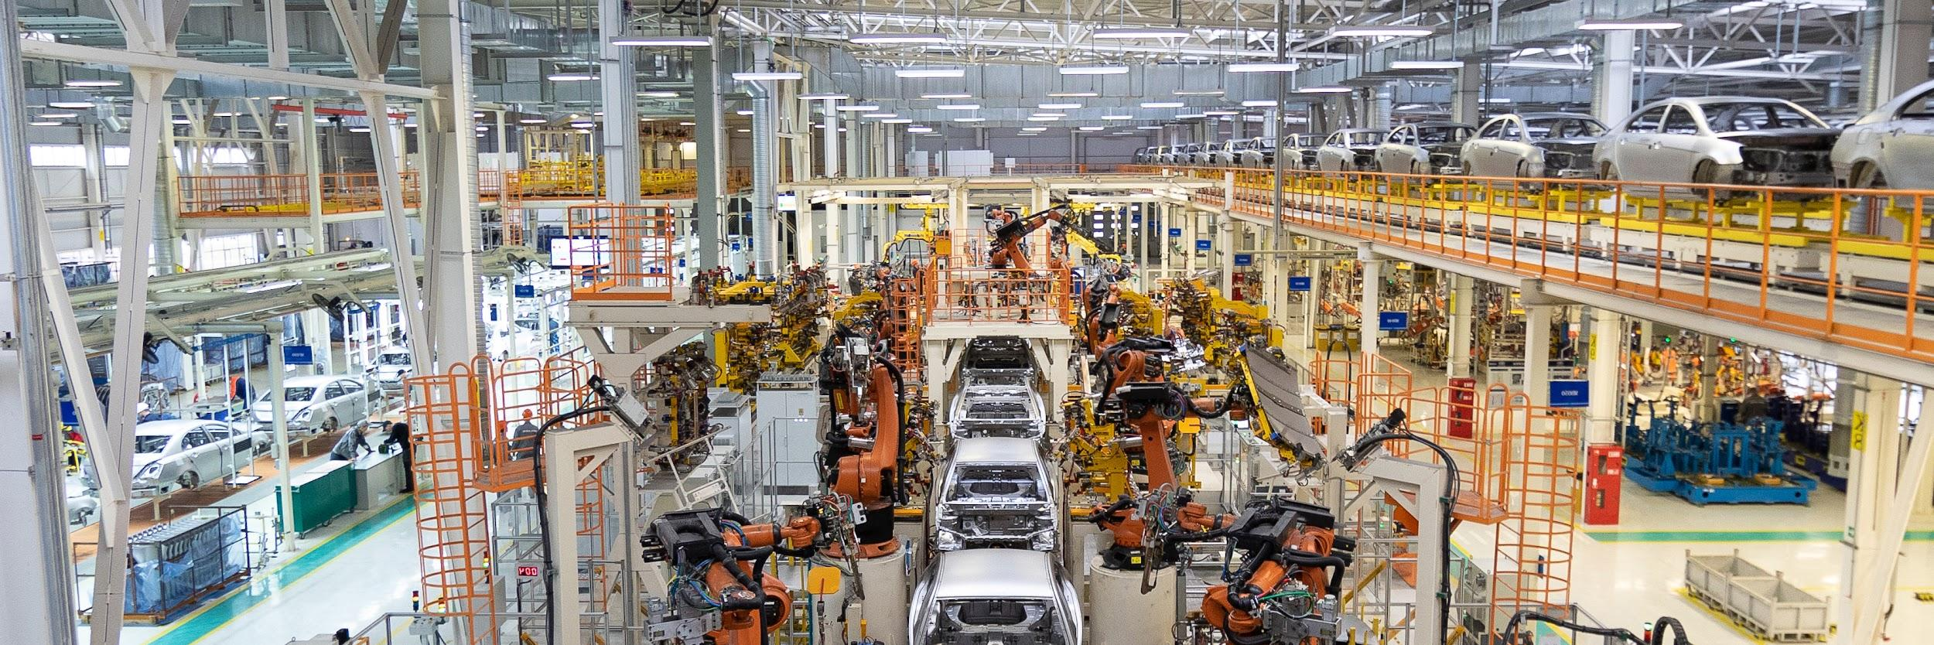
Train an ML model with examples
Labels
Algorithm
Trained model
Inputs

Slide 16


Predict with a trained model
Good
condition
Trained model
Fractured
condition
New image

Slide 17
Standard algorithm use cases
1 | Detect a pattern in an image
2 | Predict the future of a time series
3 | Understand or transcribe human speech or text

Slide 18
A standard algorithm for image classification
Class 1
Image
Trained ResNet model
Class 2

Slide 19


The same algorithm applied to other data yields a different model
Standard algorithm
Trained ResNet model
Standard algorithm
Trained ResNet model

Slide 20

The algorithm is the same, but the trained model is different
Image model (trained)
Image model (trained)
Water lily
Fractured part

Slide 21
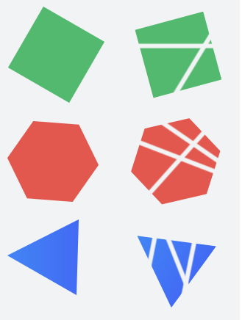
What data do you need?
Parts in good condition
Parts in fractured condition

Slide 22
ML is a type of AI
Artificial Intelligence
Machine Learning
Deep Learning

Slide 23




The impact of ML is scale
X
✓
$
$$$
Not about saving money
But about doing it at greater scale

Slide 24
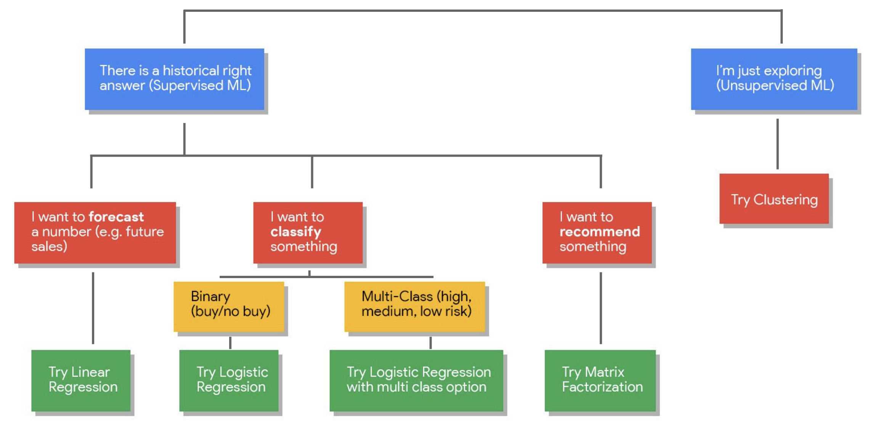
BigQuery ML
Linear regression
Logistic regression
Matrix Factorization
K-means clustering
Time series forecasting
XGBoost
Deep Neural Network (DNN)
TensorFlow model importing

Slide 25


BigQuery ML enables users to create and execute ML models in BigQuery using standard SQL queries
1 | Execute ML initiatives without moving data from BigQuery.
2 | Iterate on models in SQL in BigQuery to increase development speed.
3 | Automate common ML tasks and hyperparameter tuning.

Slide 26

Moving to Notebooks
08-01-Machine-Learning-Overview.ipynb
08-02-Classification.ipynb
08-03-Regression.ipynb

Slide 27

Activity
DataCamp
Ch 4.3 Intermediate SQL - Correlated Queries, Nested Queries, and Common Table Expressions
Ch 4.4 Intermediate SQL - Window Functions
Due Monday - 08/30
Final Project
Deliverable: updated notebook (with link to dashboard embedded)
Monday 8/30 @ 5 pm
Final presentations (fully on Zoom with the same link as the lectures)
Cohort B1: Tuesday, 8/30 - 9 a.m. - noon ET
Cohort B2: Tuesday, 8/30 - 1 p.m. - 4 p.m. ET
Last quiz on Monday

Slide 28

Qwiklab Exercise - Home
QLab R: Predict Visitor Purchases with a Classification Model in BQML - 01:15
What you will learn in this lab
Training a logistic regression model in BQML to perform classification
Evaluate the model
Improve the model by including more variables
Make predictions

Slide 29
Query From Qwiklab S Explained
WITH params AS (SELECT 1 AS TRAIN, 2 AS EVAL),
daynames AS (SELECT ['Sun', 'Mon', 'Tues', 'Wed', 'Thurs', 'Fri', 'Sat'] AS daysofweek),
taxitrips AS (SELECT
(tolls_amount + fare_amount) AS total_fare,
daysofweek[ORDINAL(EXTRACT(DAYOFWEEK FROM pickup_datetime))] AS dayofweek,
EXTRACT(HOUR FROM pickup_datetime) AS hourofday,
pickup_longitude AS pickuplon,
pickup_latitude AS pickuplat,
dropoff_longitude AS dropofflon,
dropoff_latitude AS dropofflat,
passenger_count AS passengers
FROM `nyc-tlc.yellow.trips`, daynames, params
WHERE trip_distance > 0 AND fare_amount > 0
AND MOD(ABS(FARM_FINGERPRINT(CAST(pickup_datetime AS STRING))),1000) = params.TRAIN)
SELECT * FROM taxitrips

Slide 30

Your Turn - Home Session
QLab S*: Predict Taxi Fare with a BigQuery ML Forecasting Model - 01:00
What you will learn in this lab
Training a regression model in BQML
Evaluate the model
Improve the model by ignoring parts of the data
Make predictions

